Slide 1
English To Hindi
Machine Translation
NLP
Team: Sreekar, Ujwal, Indhiresh

Slide 2
Dealing with Data
Collection
Preprocessing
Custom Dataset
Manual scraping from the official Yale website.
128 samples collected for English-to-Hindi machine translation.
Utilization of Google Translate for English to Hindi translations.
creation of dictionaries for word-to-index, word-to-count, index-to-word, and vocabulary.
Textual data transformations, including removal of special characters, conversion to lowercase, and elimination of trailing white spaces.
Computation of vocabulary sizes for both English and Hindi languages.
Implementation of a custom dataset class for model training.Use of PyTorch DataLoader for efficient loading with a batch size of 8.
Addressing imbalanced tensor sizes through a collate function incorporating padding techniques.
Dataset split into training, testing, and validation subsets.

Slide 3
MarianMT Model
Utilization of pretrained MarianMTModel for machine translation.
Encoder-decoder architecture with shared embeddings.
Encoder with six MarianEncoderLayers, self-attention mechanisms, and feedforward neural networks.
Decoder mirroring encoder structure with six MarianDecoderLayers, self-attention, and additional attention mechanism.
Language Model (LM) head for predicting next tokens.
Overall sequence-to-sequence architecture designed for machine translation tasks.

Slide 4
Training and Fine-Tuning Hyperparameters
Step 1
Step 2
Step 3
Comprehensive training loop for sequence-to-sequence model.
Fine-tuning phase with focus on learning rates and momentum rates.
Learning rate experiment (0.001, 0.01, 0.1) for 30 epochs each.
Momentum rate tuning with fixed learning rate (0.01) and exploration of different momentum rates (0.1, 0.5, 0.9).
Model state saved when validation loss improves.

Slide 5
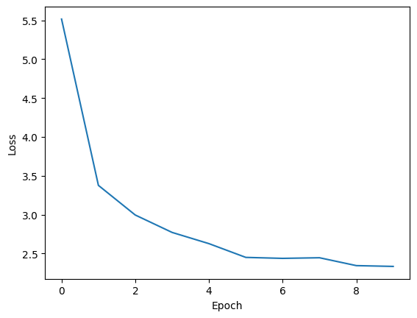
Training and Fine-Tuning Hyperparameters

Slide 6
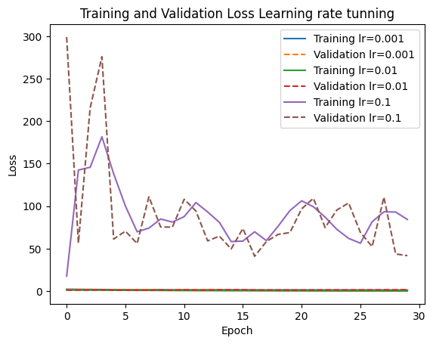
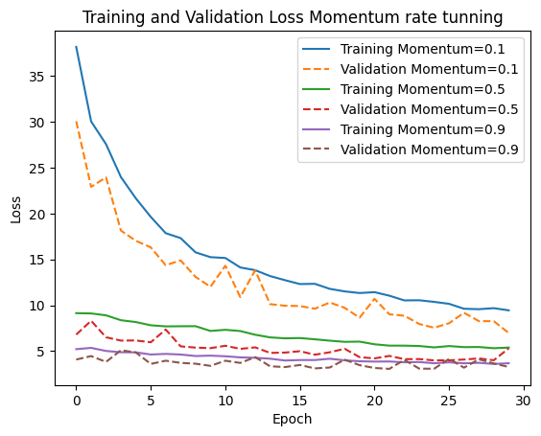
Simulations and Optimization
Examination of how the model's performance evolves over epochs in response to learning rate adjustments.
Fine-tuning insights, showcasing the model's adaptability to different momentum rates.
Emphasis on the importance of careful hyperparameter tuning in achieving optimal translation results.

Slide 7
Thank You

